Slide 1
API4KP API for Knowledge Bases and Knowledge Platforms
Revised Submission (preview) ad/2020-08-13 Response to RFP ad/2010-06-09
Davide Sottara, PhD Principal Knowledge Engineer, Mayo Clinic

Slide 2
Background
Large Scale Knowledge-Driven applications require complex, heterogeneous Knowledge Bases
OWL Ontologies
RDF Graphs w/ SPARQL
UML (Class) Models
BPMN / DMN / CMMN Process Models
PMML Predictive Models
RuleML / RIF / SWRL / CL Rules
GraphQL
APIs, when exist, are proprietary and/or strongly coupled
to Languages (e.g. OWL-APIs)
to Engines/Reasoners (e.g. any commercial BxMS)
to Business Domains (e.g. FHIR in healthcare)

Slide 3
Background
Original RFP addressed (OWL) ontology KBs only
(older versions of) OWL-API and Jena the only options
“micro-API”
Decouple representation from reasoning
Response generalizes the proposal
Add management and delivery dimensions
Supports other kinds of representable knowledge, and languages for the expression thereof
Supports the notion of Composite (heterogeneous) KBs

Slide 4
Revised Submission Group
Various Contributors from multiple Organizations over time
Submitters
88 Solutions
Thematix Partners LLC
Supporters
Arizona State University
Athan Services
Cognitive Medical Systems
Federated Knowledge
Fraunhofer FOKUS / Freie Universitat Berlin / Universitat Leipzig
Mayo Clinic
Micro Focus
Model Driven Solutions
U.S. Department of Commerce (NIST)
Otto von Guericke University of Magdeburg
Raytheon Technologies Company

Slide 5
Submission Scope
APIs for Knowledge Platforms, to be used in the development of Knowledge-based Applications
Semantics of the Operations exposed by means of the APIs
Decomposition of the Operations into simpler Actions
Definition of ‘Knowledge Base’, ‘Knowledge Resource’ and related concepts
Definition of ‘Knowledge Platform’ in terms of the functional roles of its major components
Information Models realizing Descriptions (‘metadata’) of Knowledge Resources minimally viable for Knowledge Management and Delivery
including Vocabularies to designate Knowledge Representation Languages/Notations and related concepts

Slide 6
Specification Artifacts
API4KP Ontologies owl-v2 [DL] + rdf / xml
OWL / SKOS MIREOT
API4KP Terminologies owl-v2 [skos] + rdf / xml
SKOS Compiler
Enums java-v11
SKOS to XSD
Resource Model uml-v2.5 + xmi / xml
XMI to XSD
Resource Schemas xsd + xml
JaxB
POJO Classes java-v11
Swagger to IDL
Resource Schemas xsd + xml
Operations Interfaces IDL-v3
Swagger to IDL
Web API Spec openapi-v2 + yaml
Swagger Codegen
(Web) Service java-v11 [spring]
Swagger to HTML
API Documentation html

Slide 7
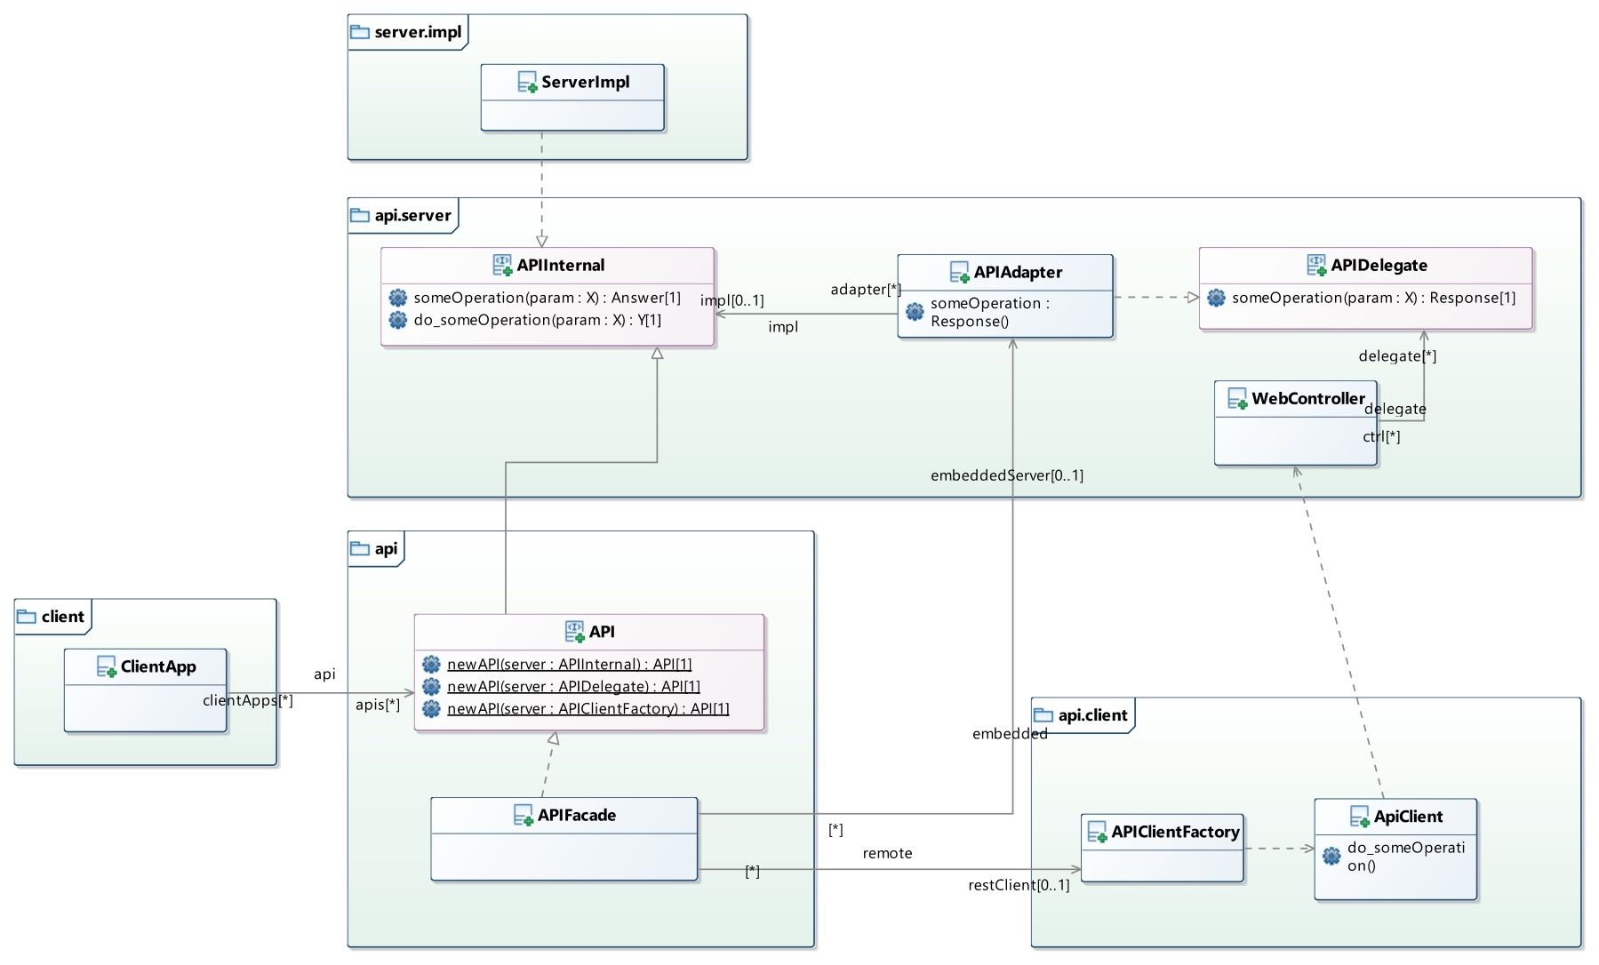
API Integration

Slide 8
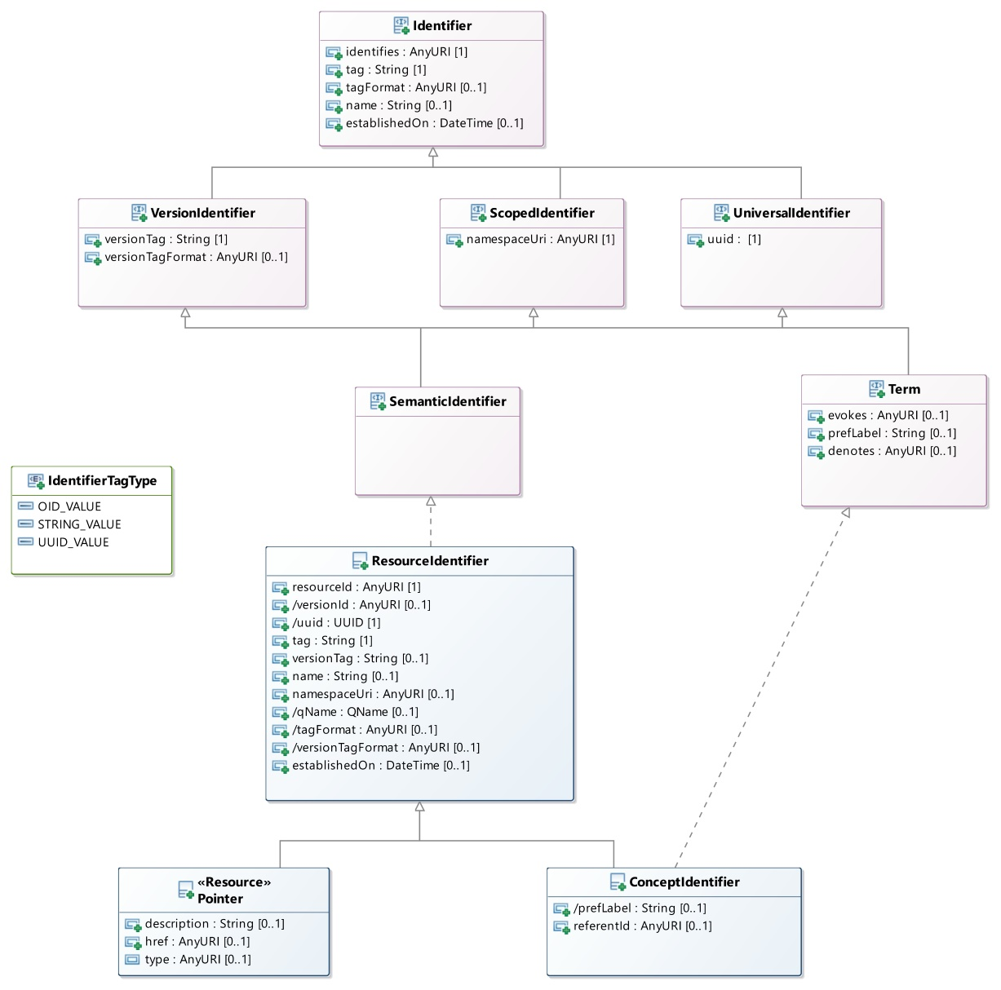
Core Module / Identifiers

Slide 9
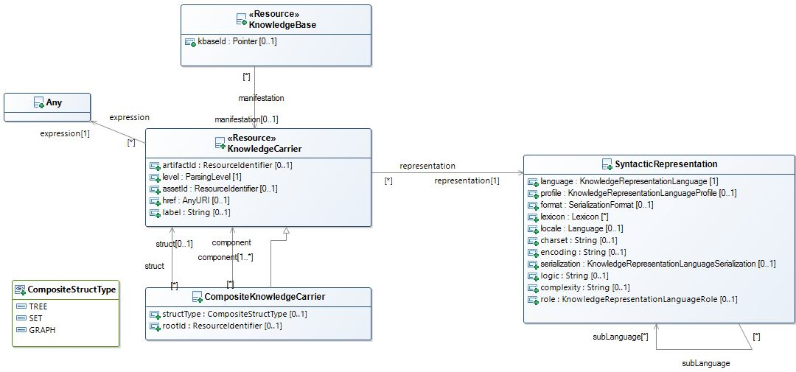
Core Module / “Carriers”

Slide 10
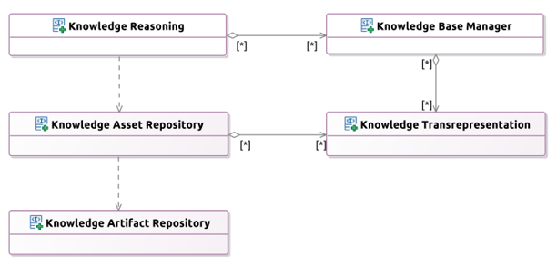
Service Architecture
Modular, Resource-Oriented

Slide 11
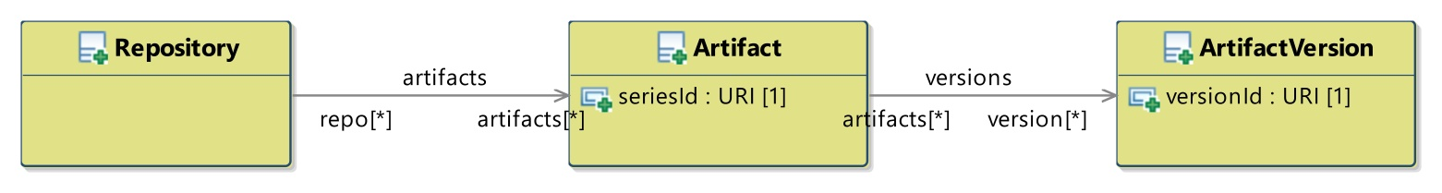
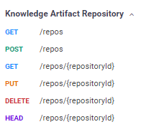
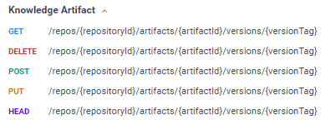
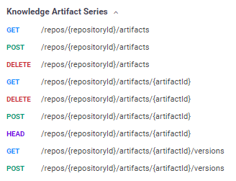
Artifact Repository APIs (KAR)

Slide 12
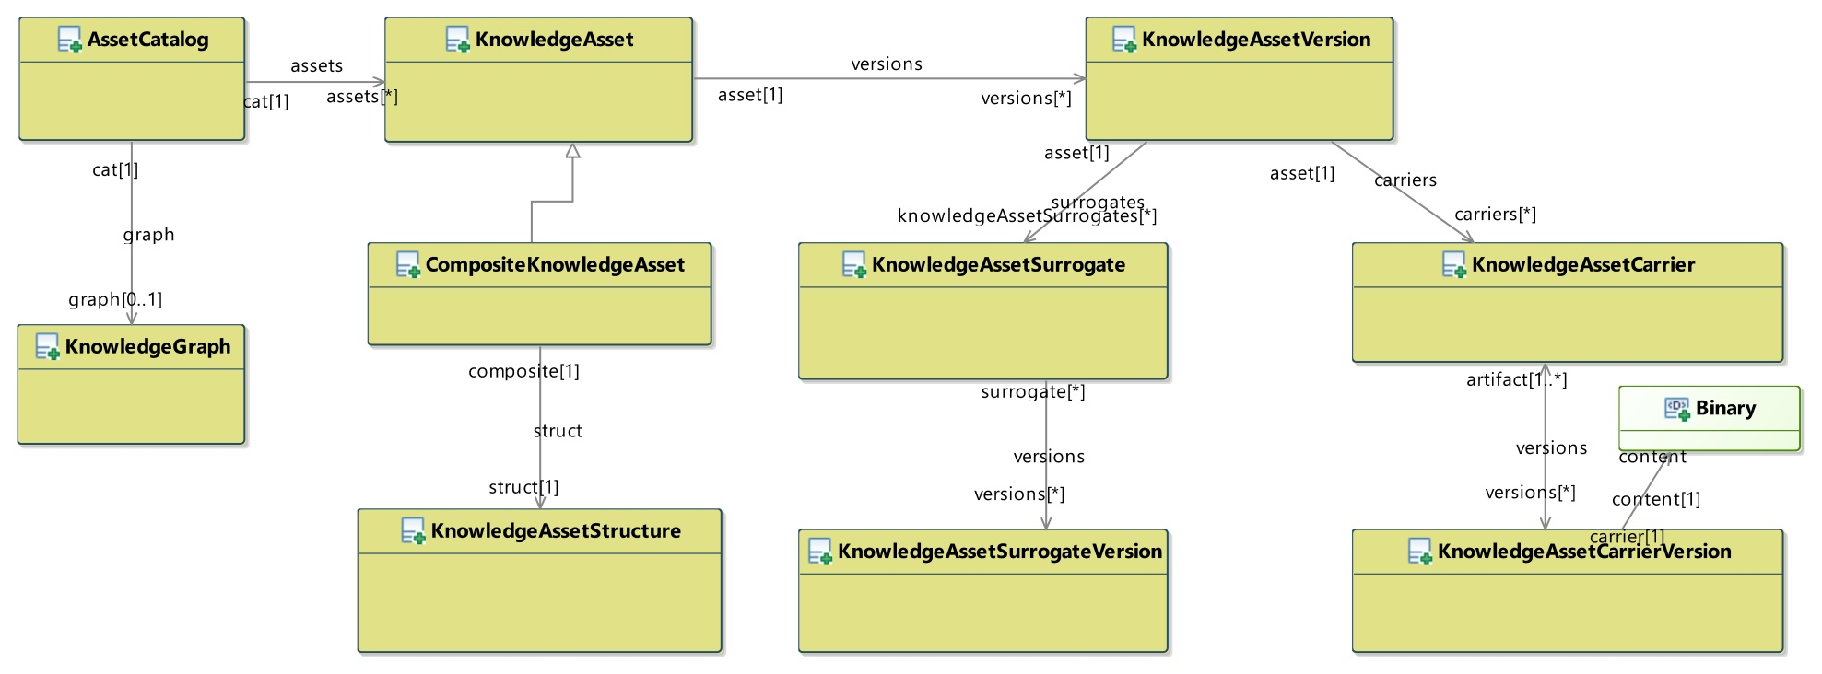
Asset Repository APIs (KASR)

Slide 13
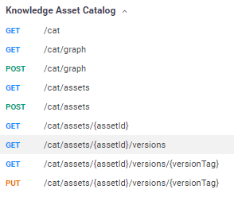
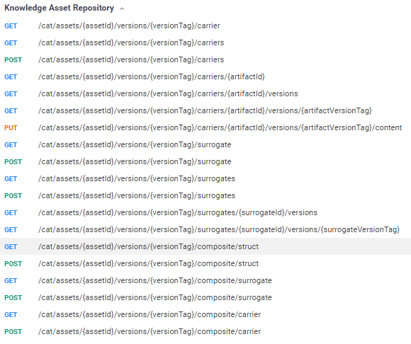
Asset Repository APIs

Slide 14
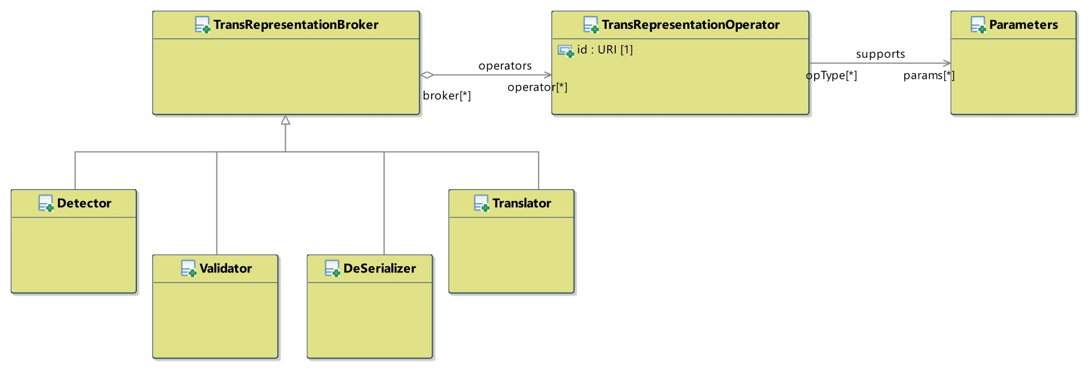
Language T*ion APIs (Tx)

Slide 15
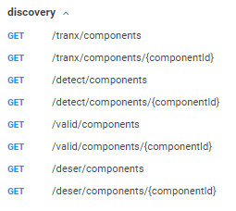
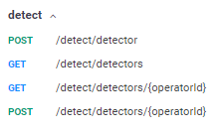
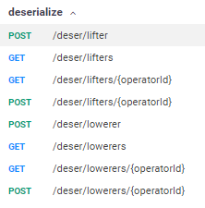
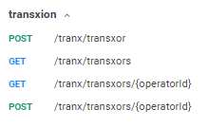
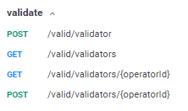
Language T*ion APIs (Tx)

Slide 16
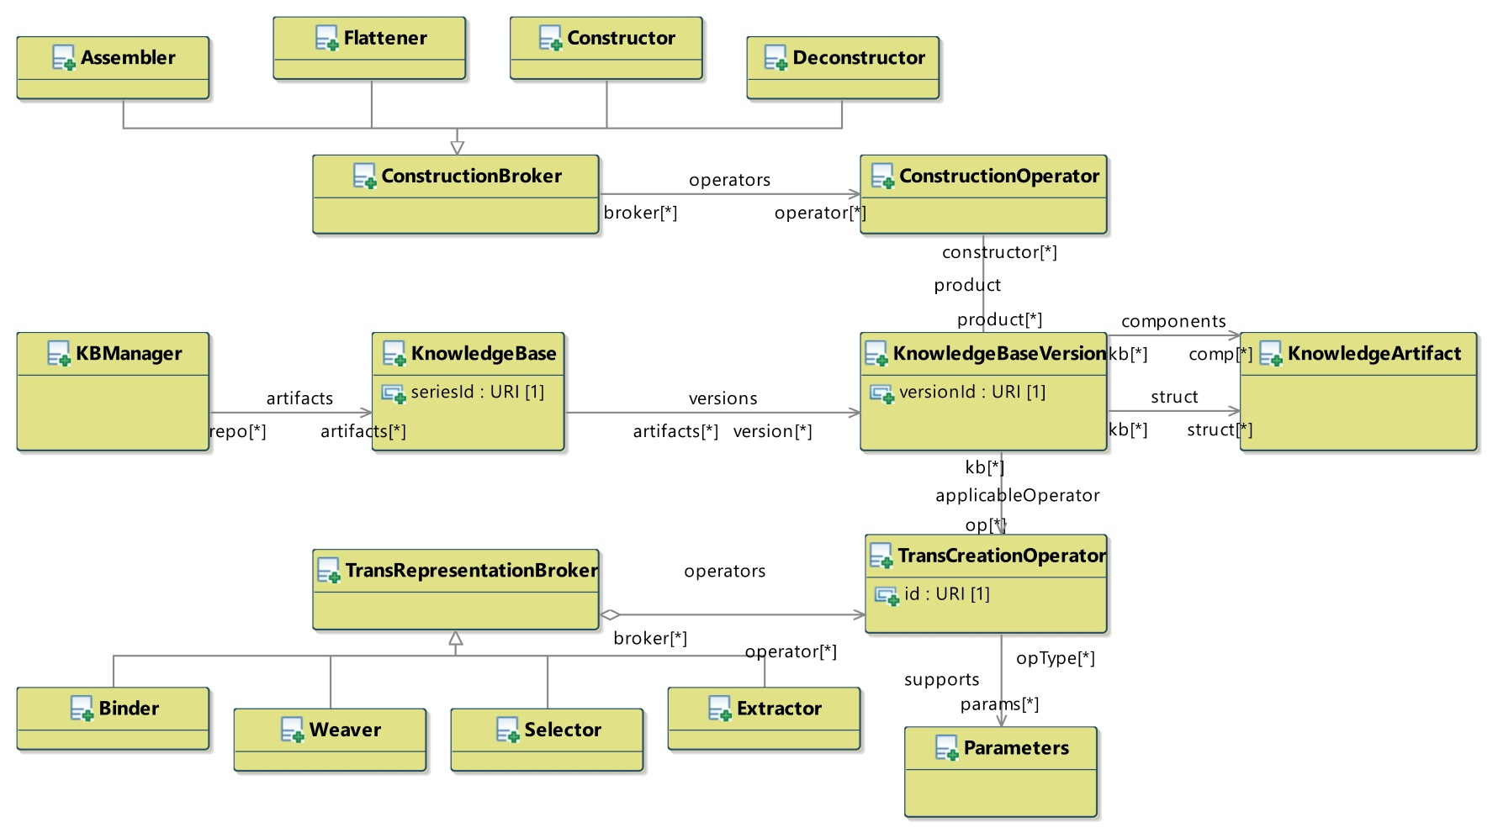
Knowledge Base Manager APIs (KB)

Slide 17
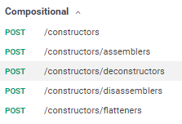
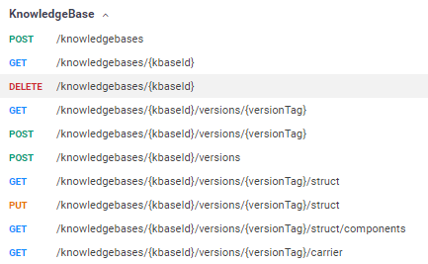
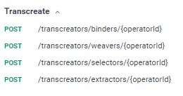
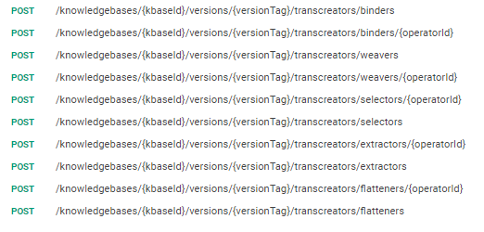
Knowledge Base Manager APIs (KB)

Slide 18
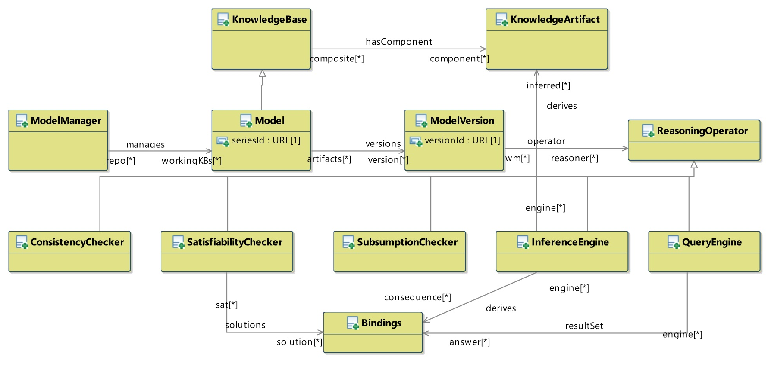
Inference/Reasoning APIs (Inf)

Slide 19
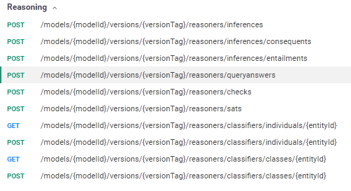
Inference/Reasoning APIs (Inf)

Slide 20
Ontologies

Slide 21
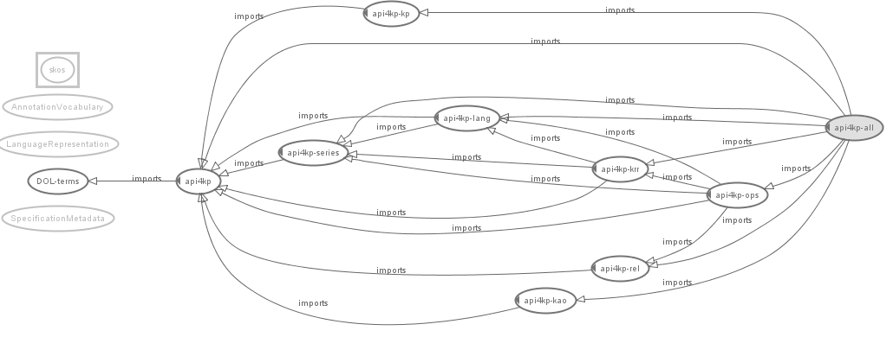
Ontologies

Slide 22
Maturity Model
Status
Not Supported : Unable to support (without major architectural changes
Not Started : On the Roadmap
Draft : Initial Definition exists
Supported : Defined, ready for implementation
In Progress : Partial implementation exists
Implemented : 1+ example implementations finalized
Published : Stable and ready for adoption

Slide 23
Requirements
Requirements – Reference Model | Status
PIM model expressed in UML / MOF | Implemented
UML Model – Platform Architecture | Implemented
IDL Model – Operations specification | In Progress
OWL Model – Underlying Ontology | Implemented
Most Supported+ features are nevertheless incomplete and subject to evolution

Slide 24
Requirements
Requirements – KB Interrogation | Status
List Ontologies in a KB (→ Separation / Extract of “Resources” in KB API) | Implemented
List Entities: Classes, Relationships, Datatypes and Individuals in a KB (→ Selection of “Resource Fragments” in KB API) | Implemented
List Entities logically related to an Entity: Sub-, Super-, Equivalent (→ Selection of “Resource Fragments” in KB API) | Supported
Resolve URIs of Entities to Representations thereof, and vice-versa (→ Query / Selection of “Resouce Fragments” in KB API) (→ De-referencing w/ content negotiation in KASR API) | In Progress Implemented
Test the (structural) Equivalence of two Entities given their representation (→ Parse + Diff of “Resources” in KB API ) | In Progress
Most Supported+ features are nevertheless incomplete and subject to evolution

Slide 25
Requirements
Requirements – Knowledge Resource Modification | Status
Construct an Entity (Class, Rel., Individual, ...) in an Ontology (→ Formulate “Resource (Fragment)” + Merge in KB API) | Supported
Delete an Entity (Class, Rel., Individual, ...) in an Ontology (→ Separate “Resource (Fragment)” in KB API) | Supported
Modification of an Entity (Class, Rel., Individual, ...) in an Ontology (Formulate + Filter with Versioning in KB API) | Supported
Most Supported+ features are nevertheless incomplete and subject to evolution

Slide 26
Requirements
Requirements – KP Inference | Status
Check the Consistency of a KB (→ Check Consistency in Inf API) | Supported
Check the Satisfiability of a KB (→ Check Satisfiability in Inf API) | Supported
Test the (mutual) entailment / equivalence between two KBs (→ Check Entailment in Inf API) | Supported
Test the (mutual) subsumption between two Expressions Retrieve all the subsuming/ed Entities given an Expression (→ Check Subsumption in Inf API) | Supported
Test for Class membership of an Individual Retrieve all the Classes an Individual is member of Retrieve all members of a Class (→ Check Memberhsip in Inf API) | Supported
Answer (conjunctive) Queries (→ Query in Inf API ) | Implemented
Most Supported+ features are nevertheless incomplete and subject to evolution

Slide 27
Requirements
Requirements – KB Manipulation | Status
Load an OWL Ontology or a RDF Graph in a KB) (→ Add Resource to KB in KB API ) | Implemented
Unload Ontology from KB (→ Remove Resource from KB in KB API ) | In Progress
Export and Serialized Ontology (→ Lift/Lower Operations in Tx API) | Implemented
Most Supported+ features are nevertheless incomplete and subject to evolution

Slide 28
Requirements
Requirements – PSM | Status
Bind PIM to JAVA | Implemented
Bind PIM to WSDL | Draft
Bind PIM to REST | Implemented
Support PSM Serializations / Implementations | In Progress
Most Supported+ features are nevertheless incomplete and subject to evolution

Slide 29
Additional Featuers
Supported Capabilities | Status
Identification and Versioning (→ All operations) | Implemented
Composite Knowledge Resources (→ Construct, Assemble, Flatten in KB API) (→ Tx and KASR API map natively ) | Implemented
Operator Negotiation (→ apply vs namedApply) | Implemented
Discover / Describe Knowledge Resources w/ metadata (→ KASR API) | Implemented
Content Negotiation (→ getCarrier in KASR API) | Implemented
Syntactic Manipulation (→ ‘Horizontal’ operations in Tx API) | Implemented
Most Supported+ features are nevertheless incomplete and subject to evolution

Slide 30
Summary
API Status | Status
Knowledge Artifact Repository | Implemented
Knowledge Asset Repository | Implemented
Transrepresentation | Implemented
KnowledgeBase Construction | In Progress
Inference / Reasoning | Draft / In Progress
Most Supported+ features are nevertheless incomplete and subject to evolution

Slide 31
Roadmap
Future Capabilities | Status
Stateful Reasoning (→ Inf API) | Roadmap
Error Handling | Draft
Explanations / Proofs | Draft
OpenAPI 3.0 | Roadmap
Most Supported+ features are nevertheless incomplete and subject to evolution

Slide 32
Next Steps
Refine the Documentation of the Specification
Consolidate the various PIM/PSM alignments
UML (interfaces) / IDL / OpenAPI / WSDL
UML (classes) / XSD / JSON(LD) schemas
Add / Publish examples
Demonstrate integration with:
GraphQL
OWL-API, Jena, and other Semantic Web APIs
Cyc and other ‘Knowledge Bases’
Popular Rule Engines

Slide 33
Implementation Use Cases
Mayo Clinic “KMDP API Portfolio”
Care Process Models (BPM+ 4 Health, FHIR)
Process / Ontology / Terminology / Patient Data integration points
Individualized Content
Knowledge Asset Repository Facades
Wrap Mayo Clinic’s native:
Content Management System
BPM+ System Authoring / Repository
Electronic Health Record’s Clinical Decision Support Rule repository
Terminology Service
RDF + SPARQL
In collaboration with FraunHofer Institute
Cross-Standard Initiatives
OMG’s BPM+4Health vs HL7’s Clinical Practice Guideline on FHIR

Slide 34
Discussion
Exception / Explanation Handling
Most Operations return an (optional) Explanation secondary output
An Explanation is a Knowledge Resource itself, expressed in some KRR language
Usually provided natively by KP Components
Explanations are structured into complex Resources as Operations are chained
This capability is expected to be provided by the API layer
Provenance concepts can be leveraged by actual implementations (e.g. W3C Prov)

Slide 35
Discussion
Performance Impact
API overhead should be minimal
APIs expose, rationalizing and normalizing them, functionalities normally required to use knowledge bases and related platforms
APIs are compatible with implementations based on facades
API granularity may change to minimize the number of invocations required by common use cases, across use cases
Pilot implementation @Mayo Clinic
Web-Service oriented PSMs may be critical
(same as above)
APIs designed for chaining
Resources can be passed by Reference
Most operations are functional (→ caching) and suitable for lazy implementations

Slide 36
Discussion
Security
API specification is transparent to any security layer imposed around (i) access to Knowledge Resources and (ii) invocation of the APIs.
E.g. RESTful implementations are likely to use OAuth or other state of the art mechanisms
Caveats
Knowledge Resource Descriptions (aka “metadata”) carry licensing information, possibly expressed in a computable format
APIs can be used to abstract knowledge-based policy enforcement systems, or components thereof (e.g. access control rules implemented in a BRMS)

Slide 37
Discussion
Related Work
CTS-2
A terminology service is a special case of KP, working on KBs of a specific kind
A conceptual mapping of CTS-2 like* operations to particular configurations of API4KP operations will be provided as a corollary
DOL
API4KP is more general than DOL
DOL makes more specific assumptions about the nature of Knowledge Resources and Knowledge Bases.
API4KP reuses, generalizing them, many of the concepts and operations defined in DOL
DOL can provide API4KP services
DOL specifications describe complex KB, and are Knowledge Resources themselves
DOL specifications could be interpreted in terms of (chains of) API4KP operations
Implementations of DOL operations could be exposed through API4KP

Slide 38
Discussion
Changes to ODM
No need to change the ODM has arisen
Standard URIs to denote logics, languages and formats for knowledge representation – and versions thereof - are needed
The role of ‘model’ MIME types is being investigated

Slide 39
Important Dates
Revised submission
Q4 2020 (11/9/2020)
Motion will be made this afternoon with other motions

